Slide 1
Human Factors Engineering
BME 6086 / BME 4985
Jeffrey Bolkhovsky, Naval Submarine Medical Research Laboratory, University of Connecticut
Jeffrey.Bolkhovsky@uconn.edu
Spring 2019

Slide 2
The ABCs of Users
Anthropomorphic
Behavior
Cognition
Social
Notes:
Anthropometrics: the shape of the body and how it influences what is
designed; consideration of the physical characteristics of intended users such
as what size they are, what muscle strength they have, and so on
Behavior: perceptual and motivational characteristics, looking at what people
can perceive and why they do what they do
Cognition: learning, attention, and other aspects of cognition and how these
processes influence design; users defined by how they think and what they
know and what knowledge they can acquire
Social factors: how groups of users behave, and how to support them through
design; users defined by where they are—their context broadly defined
including their relationships to other people.

Slide 3
Behavior
Basic psychology of the user
Things that are linked to sensation and perception.
Perception is SUBJECTIVE
Notes:
Just because you design something in one way doesn’t mean that others will perceive it that way.

Slide 4
Aspects of Behavior
Presentation of Information
Visual Perception
  Low Level
  High Level
Auditory Perception
Motivation

Slide 5
A Well Designed Interface Considers…
The ability for users to notice changes in their interface (upcoming presentation on Just Noticeable Difference)
The best ways to present information to the user.
Can the user perceive or detect information that is given to them (Signal Detection Theory)
How do you distribute information among sensory channels?

Slide 6
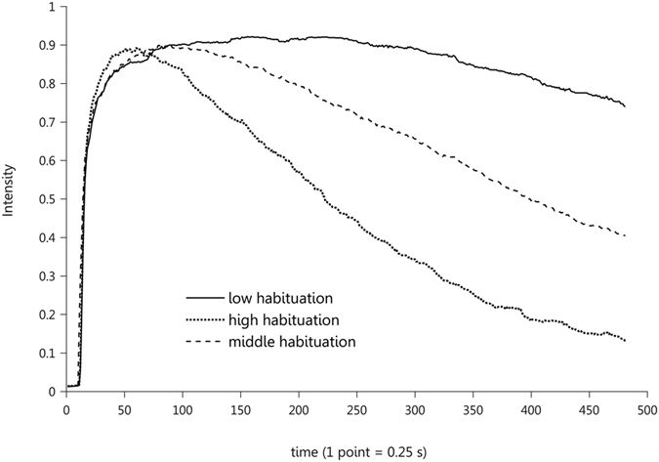
Aspects of Behavior: Habituation
Reduced Response to Stimuli Over time, Factors Include:
  Duration
  Frequency
  Intensity
  Change
[1]
[1] Sinding, C., Valadier, F., Al-Hassani, V., Feron, G., Tromelin, A., Kontaris, I., & Hummel, T. (2017). New determinants of olfactory habituation. Scientific Reports, 7, 41047.
Notes:
If a stimulus occurs repeatedly and is not
regarded as salient they will habituate to it. People who live beside a railroad track,
for example, grow accustomed to the noise of the trains to a point where they no
longer notice it.

Slide 7


Vision
Eye do not take snapshots
Does not capture everything in a scene
Selectively picks out salient objects
Eyes get features and context and then focuses
For Design:
  Understanding strengths and weaknesses
  Taking advantage of human capabilities

Slide 8
Behavior and Vision
Notes:
An interface that has to be recognized quickly and accurately

Slide 9
Physiology of the Eye
Parts of the eye: lens, retina, rods, cones, fovea, optic nerve.
Visual Angle: The angle formed at the eye by rays from the extremities of an object viewed.
Visual Acuity: The ability to discriminate two objects that are close to each other.
Fovea: Small part of retina (1-2 degrees) which permit visual acuity.
Notes:
Minimum Visual angle that can be resolved ~1 min of an arc of 1/60 of a degree

Slide 10
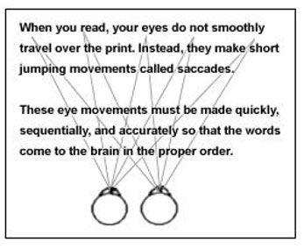
Saccades
Notes:
Only the area immediately surrounding it will appear in clear
focus, so to clearly perceive a scene of any size the eyes must move around. These
semi-conscious movements are called saccades and take approximately 200 ms to
program, and last 20–200 ms, which is just about the interval of the persistence
of vision.

Slide 11
Methods for Evaluating Eye Tracking
Notes:
A head-mounted eye-tracker and an example analysis showing the order that a user
looked at the interface (top) and how long they looked at each part (bottom) (photo by Ritter, used
with permission of the analyst pictured; analyses courtesy of Maik Friedrich 2008)

Slide 12

Ways to take Advantage/Be Wary of Vision
Changes in lighting conditions require people to adjust.
Large Dialog Box to get users attention.
Having things that move or flash are distracting.

Slide 13
Vision: Low Level
Contrast: Light emitted from an object versus its surroundings.
Notes:
Designers should be wary of creating effects like the Hermann grid
because they can be distracting. Adding color or shading
can remove this effect. Indeed, the design of folders on most modern desktops
avoids this by increasing the spacing of the icons both vertically and horizontally,
but this choice costs display space.

Slide 14
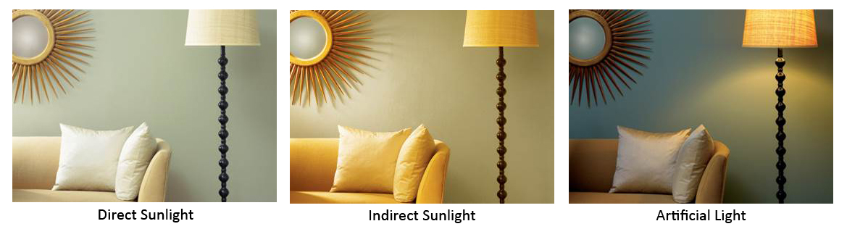
Color
Color can appear differently under different light conditions.
Color can only be discriminated up to 60 degrees straight ahead
Color constancy: We attempt to perceive colors as being the same even when different.
Notes:
It is important to be aware of color blindness (or, more strictly color vision
deficiency) because around 7% of Western men and 0.5% of Western women are
red–green color deficient.

Slide 15
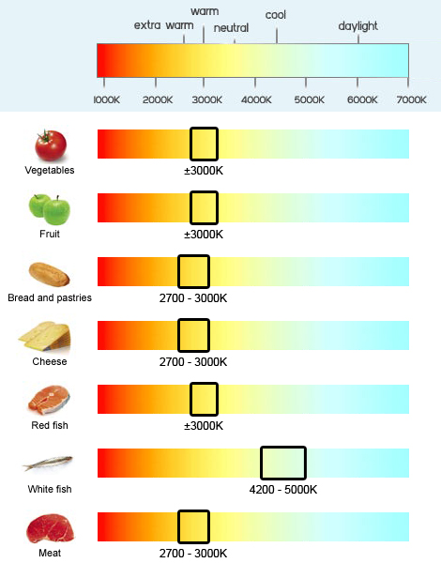
Using Color
https://www.dmlights.com
Notes:
Vegetables and meat in supermarkets are one of the most
compelling examples of constancy not working—stores tend to be lit so that
objects give off particular wavelengths—when you get home with different
lighting the colors are substantially duller.

Slide 16
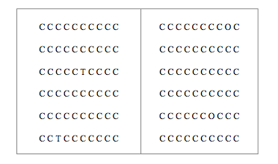

Vision Examples: Pop-Out and Word Completion
Notes:
Example of pop out and examples of word completion.
Pop Out Effects Display How different features can be used to present differences.
Word completion of French Connection: UK

Slide 17
Using Color as Popout
Notes:
The use of color and luminance on aircraft displays facilitates the finding of particular
information

Slide 18
Rules of Thumbs
Use color to emphasize things that are important.
Ensure users can perceive the colors/differences you present.
Present redundant information to help with color blindness.
Colors appear consistent across all media (screen paper).
Make important items pop-out by changing features.
Care to make sure items you don’t want popping out don’t.

Slide 19
High Level Visual Perception: Depth

Slide 20
Subitizing
Notes:
Up to three objects, you recognize the number effectively, with about 50 ms difference
per object, above four and certainly at five, you have to count the objects, so
the time to respond increases by about 250–300 ms/object. The first part of the
curve is called subitizing, and is thought to be an effect of the architecture of the
perceptual system.
Example: Phone numbers

Slide 21
Grouping
Notes:
Principles of Gestalt Visual Grouping:
Gestalt psychology is a philosophy of mind of the Berlin School of experimental psychology.
The big point is that a whole can be larger than its parts

Slide 22
Visual Grouping
Notes:
The spatial and
temporal relationships between elements are as important as the absolute size,
location, or nature of the elements themselves, and a sensation-based account of
perception fails to capture this.
the visual system provides us
with a much more constant view of the world than if we were simply to ‘‘see’’ the
images produced on our retinas. So, when we move about (e.g., walk down a
street), buildings appear stationary and people appear to be approximately the
same size and shape—despite the fact that their actual relative images on the retina
may be quite different.

Slide 23

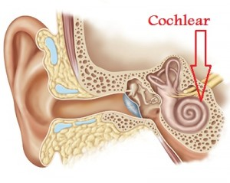
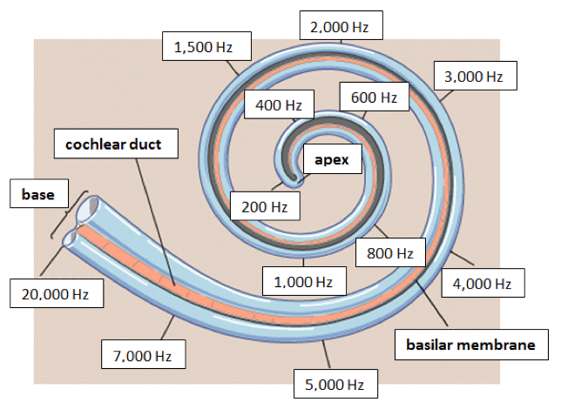
Auditory System
Human Hearing: 20Hz – 20kHz
Deteriorates with age
Notes:
Understanding the Human auditory system has lead to things like sound conduction headphones.

Slide 24
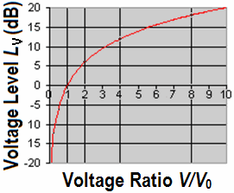
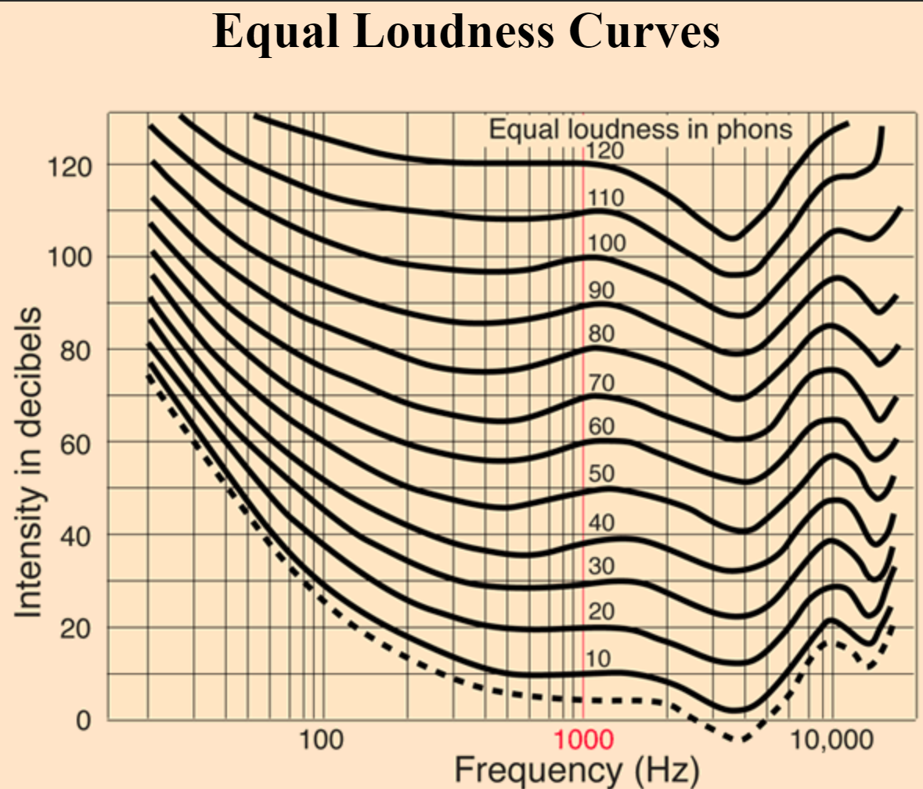
Non Linear Properties
Notes:
Decibel to power relationship not linear (3 db = 2x power)

Slide 25
Discriminating Sounds
Bad with absolute discrimination, good with relative
We can only remember 5 to 7 sounds unless we attach meaning
Can do voice output (more processing more information) vs alerts
Why assistants sound like they do
  Female voice has been found easier to understand.

Slide 26
Motivation
Two sources:
  Reactions from central nervous (e.g. eye blink)
  Deliberate decision
Best known theory of motivation: Maslow’s Hierarchy
Extrinsic vs Intrinsic Motivation
Notes:
Extrinsic Motivation: Reward
Intrinsic Motivation: Self motivation

Slide 27
Types of Motivation (Pink 2009)

Slide 28

Extrinsic Motivation Pitfalls
Notes:
For creative and non-routine work, Pink (2009) argues that the keys to high
performance are the drives to direct your own life, to extend your abilities, and to
live a purposeful life. This sort of work can be hindered by extrinsic motivations.
Deci (1971), for example, found that if you paid participants to do a simple puzzle,
they were less likely to do it while waiting to take part in the experiment (and
hence not being paid), whereas participants who were not paid were more likely to
try to solve it while waiting.

Slide 29
Intrinsic Motivation
People do a task because they like doing it or have a sense of altriusm.
Three main categories of intrinsic motivation:
  Autonomy: The ability to choose what you want to work on.
  Mastery: The desire to understand something better.
  Purpose: The desire to improve things.
Notes:
Pink argues that autonomy leads to
engagement, and engagement leads to mastery. It is not possible for every type
of situation, however, so some of the attributes are less mutable than others. If
someone is operating a safety critical system in a nuclear power plant, for
example, you really do want them to follow the rules about how they work.
Achieving mastery is most enjoyable when the task provides the right
level of challenge: too easy and it can become boring; too hard and it can create
anxiety. The balancing of knowledge to work requirements is what Vygotsky
(e.g., Chaiklin 2003) calls appropriate scaffolding or the Zone of Proximal
Development, and Csíkszentmihályi (1990) calls flow.
In Motivation 3.0, however, the purpose is related to
intrinsic motivation: people know why the task is important, and may even do it
free of charge. Emphasizing the goal of the task and its purpose can drastically
influence performance.

Slide 30
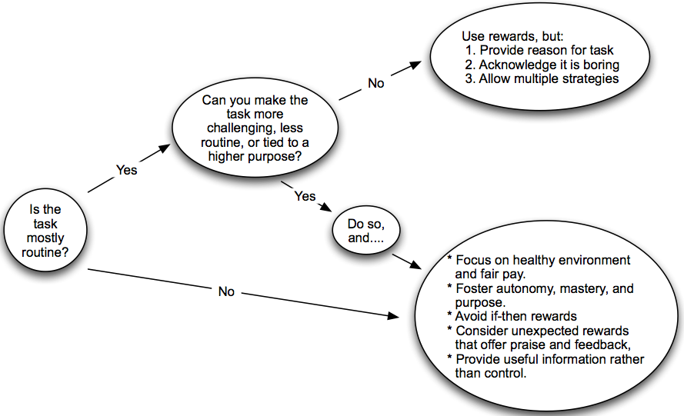
Extrinsic and Intrinsic Motivation
Notes:
At the end of the day its important to know what your users are doing and in what context. To drive the future motivation.

Slide 31

How much do you know?
Notes:
Understanding 1) What people know.
2) How people react.
3) What your motivation is.

Slide 32
Evaluating Work
What did you like?
What did you not like?
What would you do differently?

Slide 33
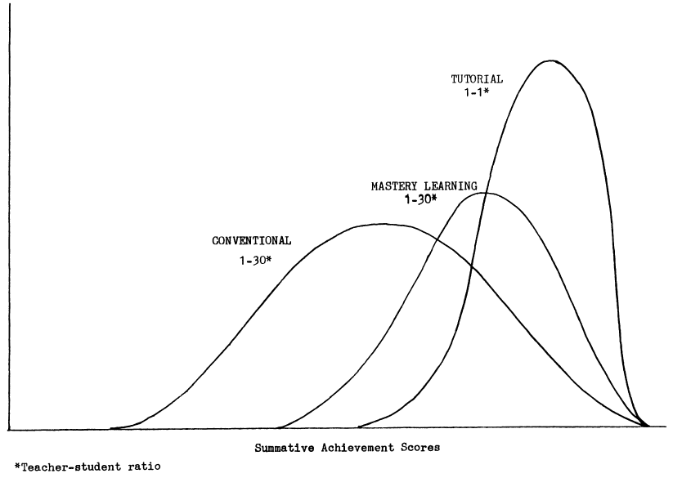
What is Bloom’s 2 Sigma Problem
Bloom found that the average student tutored one-to-one using mastery learning techniques performed two standard deviations better than students who learn via conventional instructional methods.
The average tutored student was above 98% of the students in the conventional instruction class.
~ 90% of the tutored students attained the level of achievement reached by only the highest 20% of the conventional instruction class
Notes:
In 1984, Bloom published "The 2 Sigma Problem: The Search for Methods of Group Instruction as Effective as One-to-One Tutoring"
Bloom found that the average student tutored one-to-one using mastery learning techniques performed two standard deviations better than students who learn via conventional instructional methods that is, "the average tutored student was above 98% of the students in the control class". Additionally, the variation of the students' achievement changed: "about 90% of the tutored students ... attained the level of summative achievement reached by only the highest 20%" of the control class.

Slide 34
Where Bloom Left-off
Bloom concluded that one-to-one tutoring was too costly for most societies, on any sort of a large scale.
Bloom challenged researchers and teachers to find methods to make group instruction as effective as one-to-one tutoring.

Slide 35
Welcome to the 21st Century

Slide 36
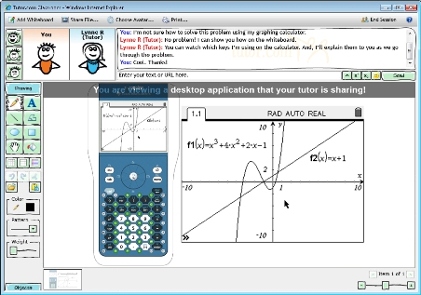
On-line tutoring
24/7 tutoring on-line with a real person

Slide 37
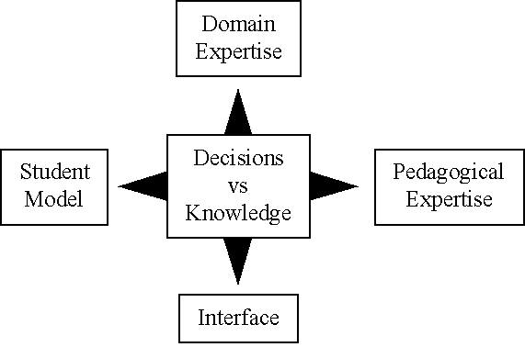
Intelligent Tutoring Systems
Artificial Intelligent system are being developed to augment the class instructions.

Slide 38
Assessment of Tutoring Systems

Slide 39
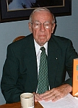
Who is Donald Kirkpatrick
Professor Emeritus of the University of Wisconsin
Past president of the American Society for Training and Development (ASTD)
Best known for creating the four levels of training evaluation, first published in 1959, in a series of articles in the US Training and Development Journal.
Notes:
Professor Emeritus of the University of Wisconsin
Past president of the American Society for Training and Development (ASTD).
He is best known for creating a highly influential model for training program evaluation, consisting of four levels of training evaluation (see also Course evaluation). Kirkpatrick's ideas were first published in 1959, in a series of articles in the US Training and Development Journal but are better known from a book he published in 1975 entitled, "Evaluating Training Programs".

Slide 40
Kirkpatrick’s Four-Level Assessment Model
Reaction - what students thought and felt about the training (satisfaction; “end of term evaluation form")
Learning - the resulting increase in knowledge and/or skills, and change in attitudes (“end of term exam score”)
Behavior - transfer of knowledge, skills, and/or attitudes from classroom to the job (change on-the-job behavior due to training program)
Results - the final results that occurred because of attendance and participation in a training program (can be monetary, performance-based, etc.)
Notes:
Reaction: A measure of how trainees feel about the various aspects of a training program, including the topic, speaker, schedule, and so forth. Reaction is basically a measure of customer satisfaction. It’s important because management often makes decisions about training based on trainees’ comments. Measuring reaction also ensures that trainees are motivated and interested in learning.
Learning: This is a measure of the knowledge acquired, skills improved, or attitudes changed due to training. Some programs aim to improve trainees’ knowledge of concepts, principles, or techniques. Others aim to teach new skills or improve old ones. And some programs, such as those on diversity, try to change attitudes.
Behavior: This is a measure of the extent to which trainees change their on-the-job behavior because of training. It’s commonly referred to as transfer of training.
Results: This is a measure of the final results that occur due to the training, including increased sales, higher productivity, bigger profits, reduced costs, less employee turnover, and improved quality.

Slide 41
Kirkpatrick’s Model
(Critique and Response)
“The Flawed Four-Level Evaluation Model,” written by Elwood F. Holton of Louisiana State University, in Human Resource Development Quarterly, Spring 1996 said that the four level model is too simple. Houlton claims that the model is not a model at all, but a taxonomy or classification.
Kirkpatrick (1996) concedes that Holton may be correct. However, he does not care whether it is a model or taxonomy, as long as training professionals find it useful in evaluating training programs.
“It [the Four-Level Model] is simple and practical. Many trainers aren’t much interested in a scholarly, complex approach. They want something they can understand and use.” (Kirkpatrick, 1996)

Slide 42
Dimensions rather than Levels/Steps
Behavior
(Transfer of Training)
Learning
(Knowledge, skills, attitude)
Reaction
(Trainee’s feelings)
Results: This is a measure of the final results that occur due to the training, including increased sales, higher productivity, bigger profits, reduced costs, less employee turnover, and improved quality. However, the final results are often dominated by factors outside of training.

